Slide 1
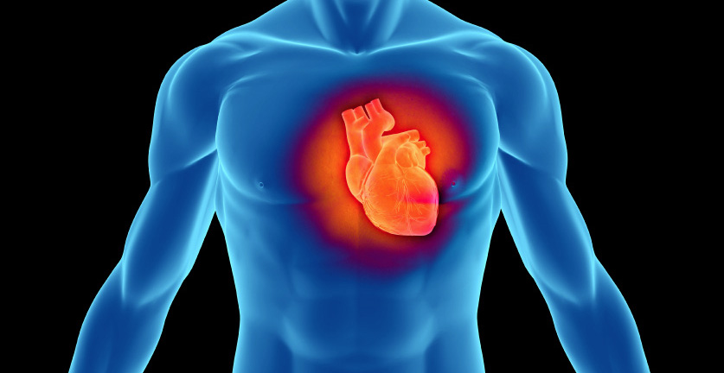
Cardiovascular Health of Young Adults
A Comparative Study
National Conference on Undergraduate Research
April 12, 2013
La Crosse, Wisconsin
By: Gina Fitzgerald, Gabriella Smith and Don Thompson, Ph.D.
Pepperdine University

Slide 2
Introduction
Cardiovascular disease is the leading cause of death among adults in the US
Cardiovascular disease is leading cause of death among the US Latinos
Risk factors for various cardiovascular diseases preexist in childhood and young adults
Few literature sources on the prevalence and risk factors of cardiovascular disease in young adults
Cross-cultural comparative study was proposed to evaluate the risk factors and indicators of cardiovascular disease in young adults in both the United States and Argentina
  Focused on population habits, health and health histories while keeping socioeconomic status, age, and nationality constant
Hypothesized that those with high prevalence of CVD risk factors (high BMI, smoking, not exercising, etc.) are more likely to show an increase of CVD indicators, i.e., have a heart rate and blood pressure outside an acceptable range.

Slide 3
Methods
A survey assessed 500 students from Buenos Aires, and 500 students from Malibu in the areas of
  Current medical information
  Personal health history
  Family health history
  Personal habits
  Demographic information
  Knowledge of cardiovascular health.
Additionally, blood pressure, heart rate were recorded.
International students, and those outside the 18-25 age range were omitted from final analysis

Slide 4
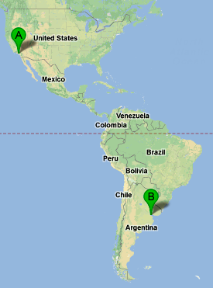
Data
Argentina
  Total Sample Size = 399
  Female Sample Size = 241
    Average Age = 20.47
  Male Sample Size = 158
    Average Age = 20.87
USA
  Total Sample Size = 195
  Female Sample Size = 101
    Average Age = 19.95
  Male Sample Size = 94
    Average Age = 19.82

Slide 5
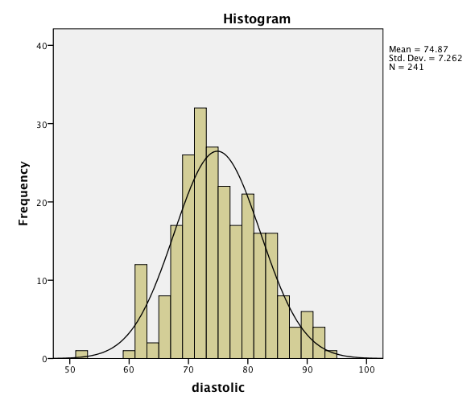
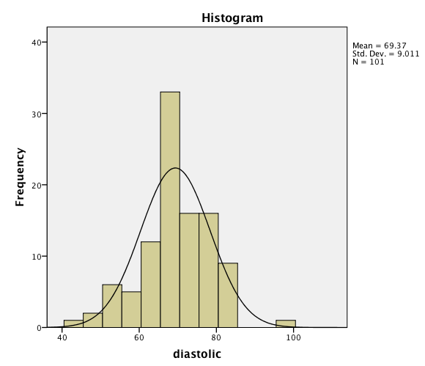
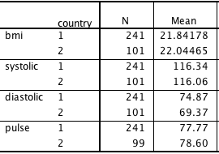
Two Sample T-Test: Argentine Females vs. US Females Health
Figure 1: Argentine Female Diastolic Blood Pressure
Figure 2: US Female Diastolic Blood Pressure
From a two sample t-test, the diastolic blood pressure difference of the population means of Argentine and US females was found to be significantly different from 0 with p-value < 0.001. The 95% CI is (3.678, 7.323) and so the Argentine female population has a higher mean diastolic blood pressure. We also tested the difference of means of BMI, Systolic Blood Pressure and Heart Rate but no significant differences were found.

Slide 6
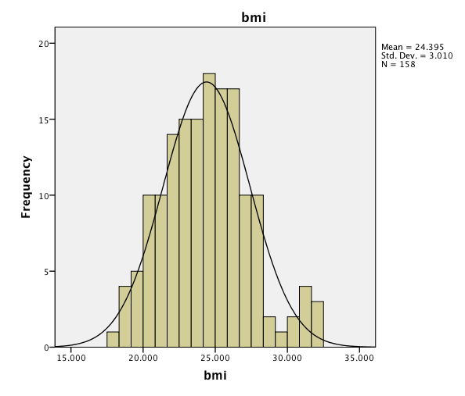
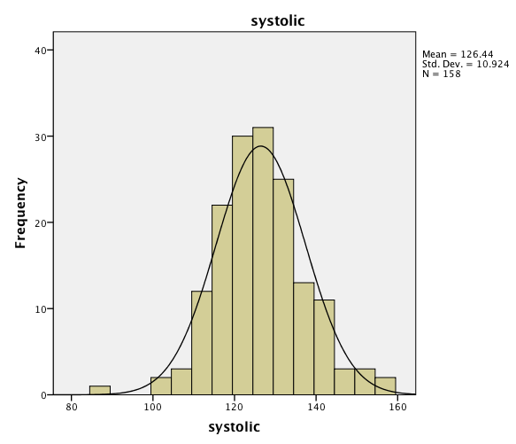
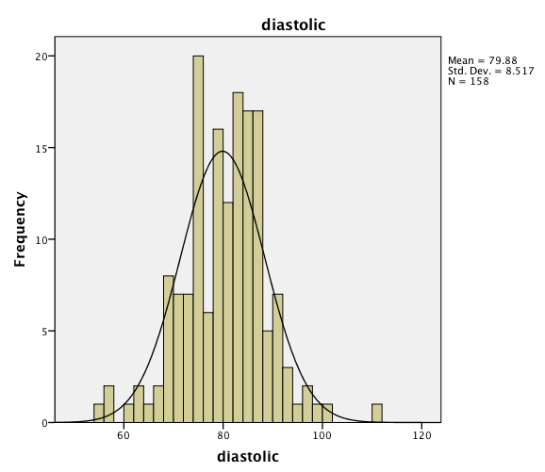
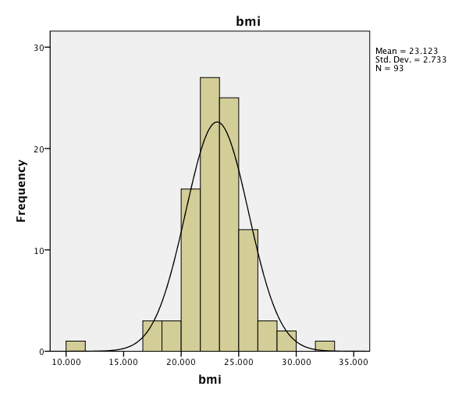
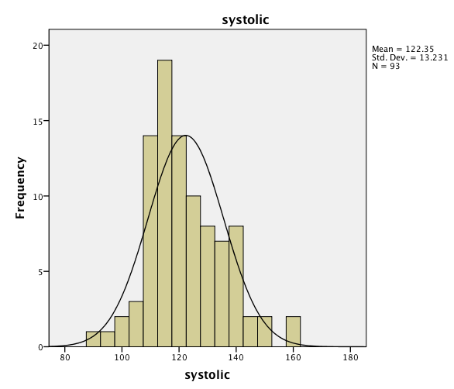
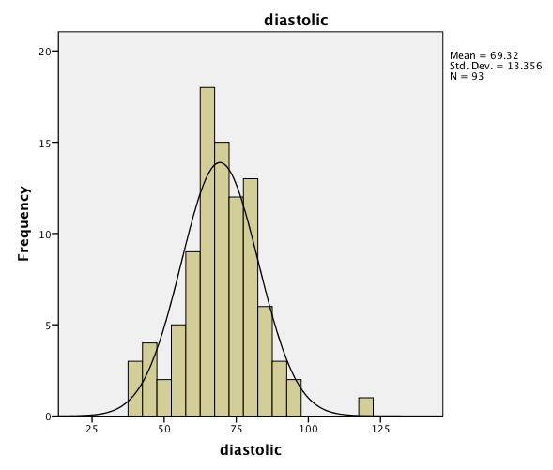

Two Sample T-Test: Argentine Males vs. US Males Health
Figure 3: Argentine Male BMI
Figure 4: Argentine Male Systolic BP
Figure 5: Argentine Male Diastolic BP
Figure 6: US Male BMI
Figure 7: US Male Systolic BP
Figure 8: US Male Diastolic BP
From a two sample t-test, the mean BMIs of the Argentine and US male populations are significantly different with a p-value = 0.001. The 95% CI about the difference is (0.474, 1.965); the Argentine male population has a higher BMI mean. The mean systolic blood pressures of the Argentine and US male populations are significantly different with a p-value = 0.009. The 95% CI about the difference is (1.029, 7.057); the Argentine male population has a higher mean systolic bp. The mean diastolic blood pressures of Argentine and US males are significantly different with a p-value of 0.000. The 95% CI about the difference is (7.820, 13.203); the Argentine male population has a higher mean diastolic blood pressure.

Slide 7
Argentine Female Correlations
 | BMI | Systolic | Diastolic | Heart Rate | Smoker | Daily Soda | 2 Fruit/ Veg Daily | Salt Food | 2 Alcohol Daily | Half Hr Daily Exercise | Fast Food
BMI | 1 | 0.235** | 0.155** | -0.108 | 0.136* | 0.024 | 0.006 | -0.094 | -0.077 | 0.072 | -0.143*
Systolic BP |  | 1 | 0.723** | 0.037 | -0.030 | 0.005 | 0.036 | 0.001 | 0.038 | 0.095 | -0.051
Diastolic BP |  |  | 1 | 0.195** | 0.004 | -0.049 | 0.047 | 0.055 | 0.007 | 0.064 | -0.041
Heart Rate |  |  |  | 1 | 0.101 | 0.077 | -0.100 | -0.012 | 0.125 | -0.157* | 0.171**
Smoker |  |  |  |  | 1 | 0.039 | -0.200 | 0.120 | 0.029 | -0.015 | 0.023
Daily Soda |  |  |  |  |  | 1 | 0.001 | 0.011 | 0.022 | -0.090 | 0.020
2 Fruit/Veg Daily |  |  |  |  |  |  | 1 | 0.010 | 0.013 | 0.081 | -0.235**
Salt Food |  |  |  |  |  |  |  | 1 | -0.060 | -0.075 | 0.138*
2 Alcohol Daily |  |  |  |  |  |  |  |  | 1 | 0.042 | 0.003
Half Hr Daily Exercise |  |  |  |  |  |  |  |  |  | 1 | -0.016
Fast Food |  |  |  |  |  |  |  |  |  |  | 1

Slide 8
US Female Correlations
 | BMI | Systolic | Diastolic | Heart Rate | Smoker | Daily Soda | 2 Fruit/ Veg Daily | Salt Food | 2 Alcohol Daily | Half Hr Daily Exercise | Fast Food
BMI | 1 | 0.123 | 0.108 | -0.045 | -0.252* | -0.021 | 0.037 | -0.115 | -0.176 | -0.053 | 0.144
Systolic BP |  | 1 | 0.225* | 0.075 | 0.096 | 0.095 | -0.106 | -0.041 | -0.017 | -0.12 | 0.042
Diastolic BP |  |  | 1 | 0.194 | 0.055 | 0.094 | 0.013 | 0.151 | -0.007 | -0.128 | 0.008
Heart Rate |  |  |  | 1 | 0.202* | -0.028 | 0.179 | -0.033 | 0.012 | 0.120 | 0.157
Smoker |  |  |  |  | 1 | 0.249* | 0.075 | 0.090 | 0.438** | 0.021 | -0.044
Daily Soda |  |  |  |  |  | 1 | -0.203* | 0.095 | 0.320** | -0.209* | -0.361**
2 Fruit/Veg Daily |  |  |  |  |  |  | 1 | -0.185 | -0.134 | 0.373** | 0.154
Salt Food |  |  |  |  |  |  |  | 1 | 0.121 | -0.111 | -0.091
2 Alcohol Daily |  |  |  |  |  |  |  |  | 1 | 0.090 | -0.218*
Half Hr Daily Exercise |  |  |  |  |  |  |  |  |  | 1 | 0.143
Fast Food |  |  |  |  |  |  |  |  |  |  | 1

Slide 9
Argentine Male Correlations
 | BMI | Systolic | Diastolic | Heart Rate | Smoker | Daily Soda | 2 Fruit/ Veg Daily | Salt Food | 2 Alcohol Daily | Half Hr Daily Exercise | Fast Food
BMI | 1 | 0.212** | 0.207** | 0.044 | 0.169* | 0.039 | 0.183* | 0.089 | -0.004 | 0.102 | -0.050
Systolic BP |  | 1 | 0.683** | -0.008 | -0.015 | -0.046 | 0.047 | -0.051 | -0.045 | 0.007 | 0.041
Diastolic BP |  |  | 1 | 0.183* | -0.068 | 0.016 | 0.016 | -0.091 | -0.043 | 0.029 | 0.103
Heart Rate |  |  |  | 1 | 0.034 | -0.010 | 0.020 | 0.121 | 0.056 | -0.107 | 0.065
Smoker |  |  |  |  | 1 | 0.048 | 0.057 | 0.062 | 0.236** | -0.027 | 0.169*
Daily Soda |  |  |  |  |  | 1 | -0.115 | 0.121 | -0.034 | 0.039 | 0.141
2 Fruit/Veg Daily |  |  |  |  |  |  | 1 | 0.049 | -0.074 | 0.209* | -0.210**
Salt Food |  |  |  |  |  |  |  | 1 | 0.018 | 0.017 | 0.118
2 Alcohol Daily |  |  |  |  |  |  |  |  | 1 | 0.043 | 0.008
Half Hr Daily Exercise |  |  |  |  |  |  |  |  |  | 1 | -0.023
Fast Food |  |  |  |  |  |  |  |  |  |  | 1

Slide 10
US Male Correlations
 | BMI | Systolic | Diastolic | Heart Rate | Smoker | Daily Soda | 2 Fruit/ Veg Daily | Salt Food | 2 Alcohol Daily | Half Hr Daily Exercise | Fast Food
BMI | 1 | 0.202* | 0.164 | -0.072 | -0.149 | 0.035 | -0.042 | 0.193 | 0.257* | -0.039 | -0.205
Systolic BP |  | 1 | 0.132 | -0.012 | -0.088 | -0.126 | 0.020 | -0.003 | 0.162 | -0.132 | -0.023
Diastolic BP |  |  | 1 | 0.014 | -0.226* | 0.107 | 0.114 | -0.038 | -0.035 | -0.053 | 0.092
Heart Rate |  |  |  | 1 | -0.016 | -0.151 | -0.101 | -0.009 | -0.187 | 0.284** | -0.045
Smoker |  |  |  |  | 1 | 0.023 | -0.148 | 0.065 | -0.038 | 0.046 | -0.126
Daily Soda |  |  |  |  |  | 1 | -0.122 | 0.131 | -0.058 | -0.132 | -0.185
2 Fruit/Veg Daily |  |  |  |  |  |  | 1 | -0.133 | -0.033 | 0.254** | 0.291**
Salt Food |  |  |  |  |  |  |  | 1 | 0.188 | -0.014 | -0.152
2 Alcohol Daily |  |  |  |  |  |  |  |  | 1 | 0.083 | -0.209*
Half Hr Daily Exercise |  |  |  |  |  |  |  |  |  | 1 | 0.199
Fast Food |  |  |  |  |  |  |  |  |  |  | 1

Slide 11
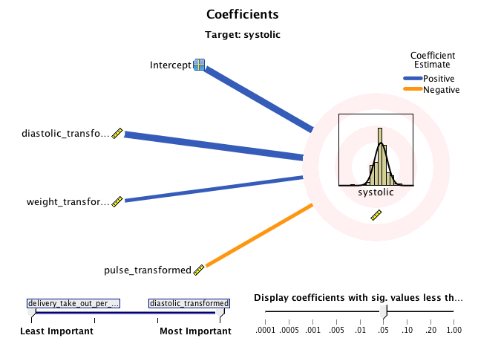
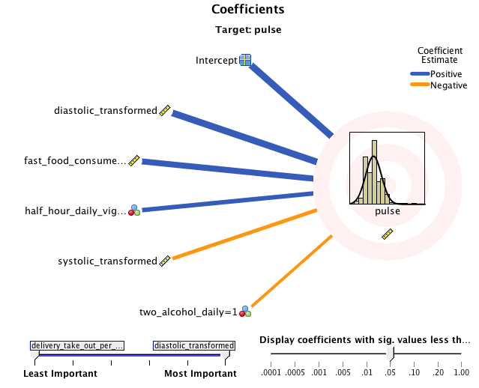
Argentine Female Regression

Slide 12
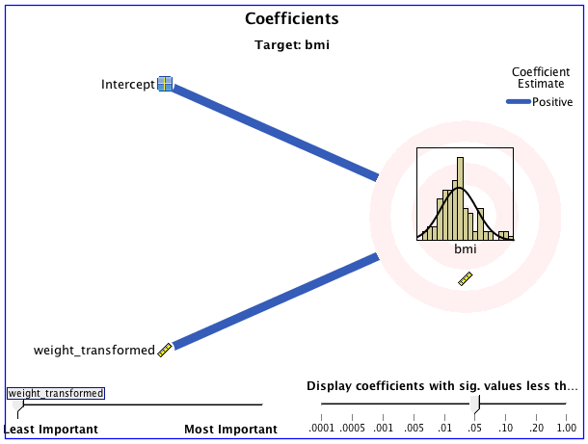
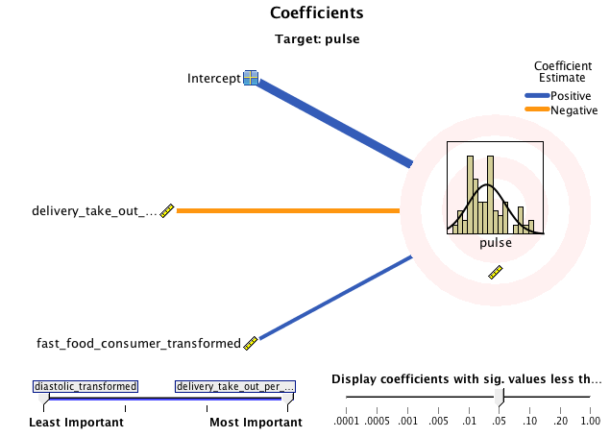
US Female Regression

Slide 13
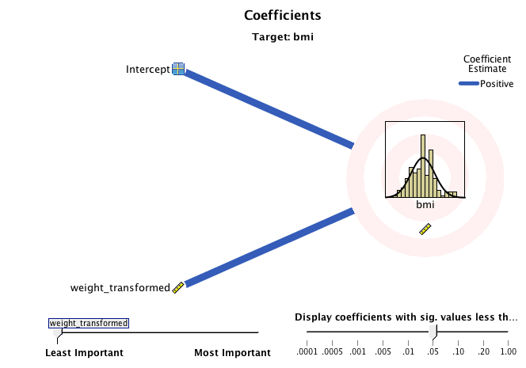
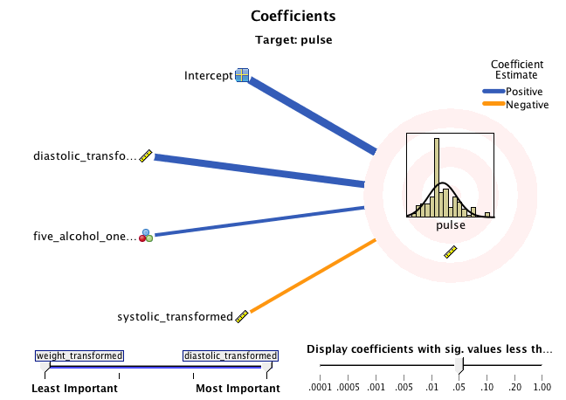
Argentine Male Regression

Slide 14
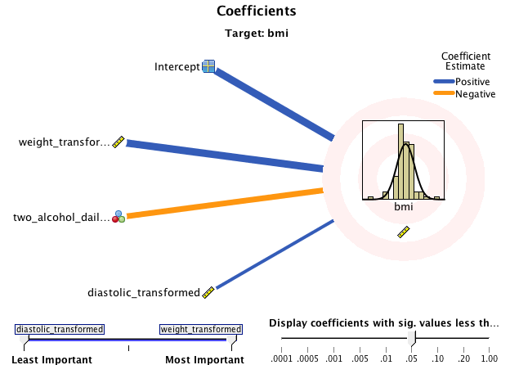
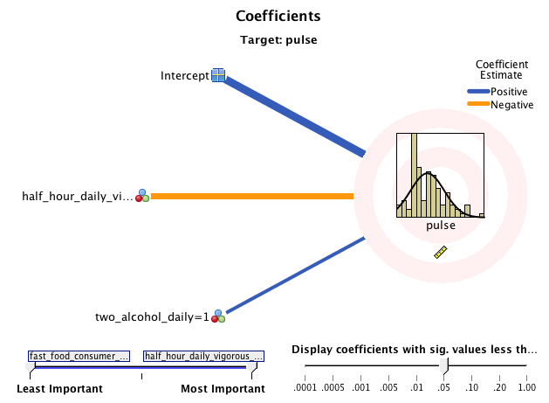
US Male Regression

Slide 15
Conclusion
Argentine Females: BMI is positively correlated with systolic and diastolic blood pressure. Smoking is positively correlated with BMI and fast food consumption is a significant predictor of an increased heart rate.
Argentine Males: BMI is positively correlated with systolic and diastolic blood pressure. Smoking is positively correlated with BMI and drinking 5+ alcoholic drinks in one night is a significant predictor of an increased heart rate.
US Females: Smoking is positively correlated with heart rate and having two daily alcoholic drinks daily. Fast Food Consumption is a significant predictor of an increased heart rate.
US Males: BMI is positively correlated with systolic blood pressure. Also, vigorous daily exercise is a significant predictor of a decreased heart rate.

Slide 16
Improvements
Personal habits section should be more quantifiable (rather than Y/N)
Personal health knowledge should contain definitions
Habits (e.g. exercise) should be defined more explicitly
Data should be collected in a more private manner to increase trust and honesty

Slide 17
Acknowledgements
Dr. Don Thompson, Ph.D.
Pepperdine Natural Science Division
Pepperdine International Programs
Dr. Rafael De Sanzo, J.D.
Juan José Herrera Paz, M.D.
Residents of Instituto Sacre Couer
Dr. Lee Kats, Ph.D.

Slide 18
Works Cited
Daviglus ML, Talavera GA, Avilés-Santa ML, et al. Prevalence of major cardiovascular risk factors and cardiovascular diseases among Hispanic/Latino individuals of diverse backgrounds in the United States. JAMA. 2012;308(17):joc1201051775-1784
Lynch, E. B., Liu, K., Kiefe, C. I., & Greenland, P. (January 01, 2006). Cardiovascular disease risk factor knowledge in young adults and 10-year change in risk factors: the Coronary Artery Risk Development in Young Adults (CARDIA) Study. American Journal of Epidemiology, 164, 12, 1171-9.
May AL, Kuklina EV, Yoon PW. Prevalence of cardiovascular disease risk factors among US adolescents, 1999-2008. Pediatrics. 2012;129(6):1035-1041
Sidney, S., Sternfeld, B., Haskell, W. L., Quesenberry, C. P. J., Crow, R. S., & Thomas, R. J. (January 01, 1998). Seven-year change in graded exercise treadmill test performance in young adults in the CARDIA study. Cardiovascular Risk Factors in Young Adults. Medicine and Science in Sports and Exercise, 30, 3, 427-33.

